Slide 1

Prompt by Design: Patterns for Real-World Problem Solving with LLMs

Slide 2

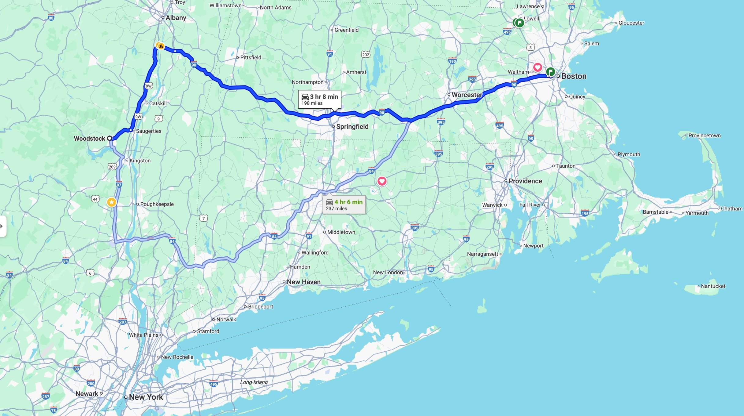
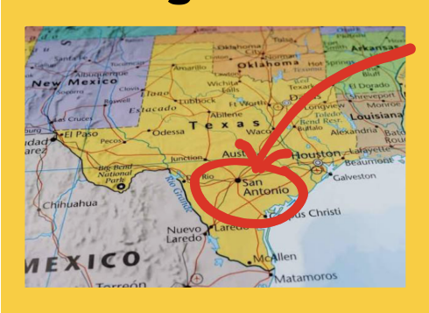
Fred Martin bio
Grew up in New York State and NYC
Went to MIT at age 17 – earned BS, MS and PhD there
Launched academic career UMass Lowell – faculty for 21 years; admin leader for 12 of those
Joined UT San Antonio as chair of computer science in 2023

Slide 3

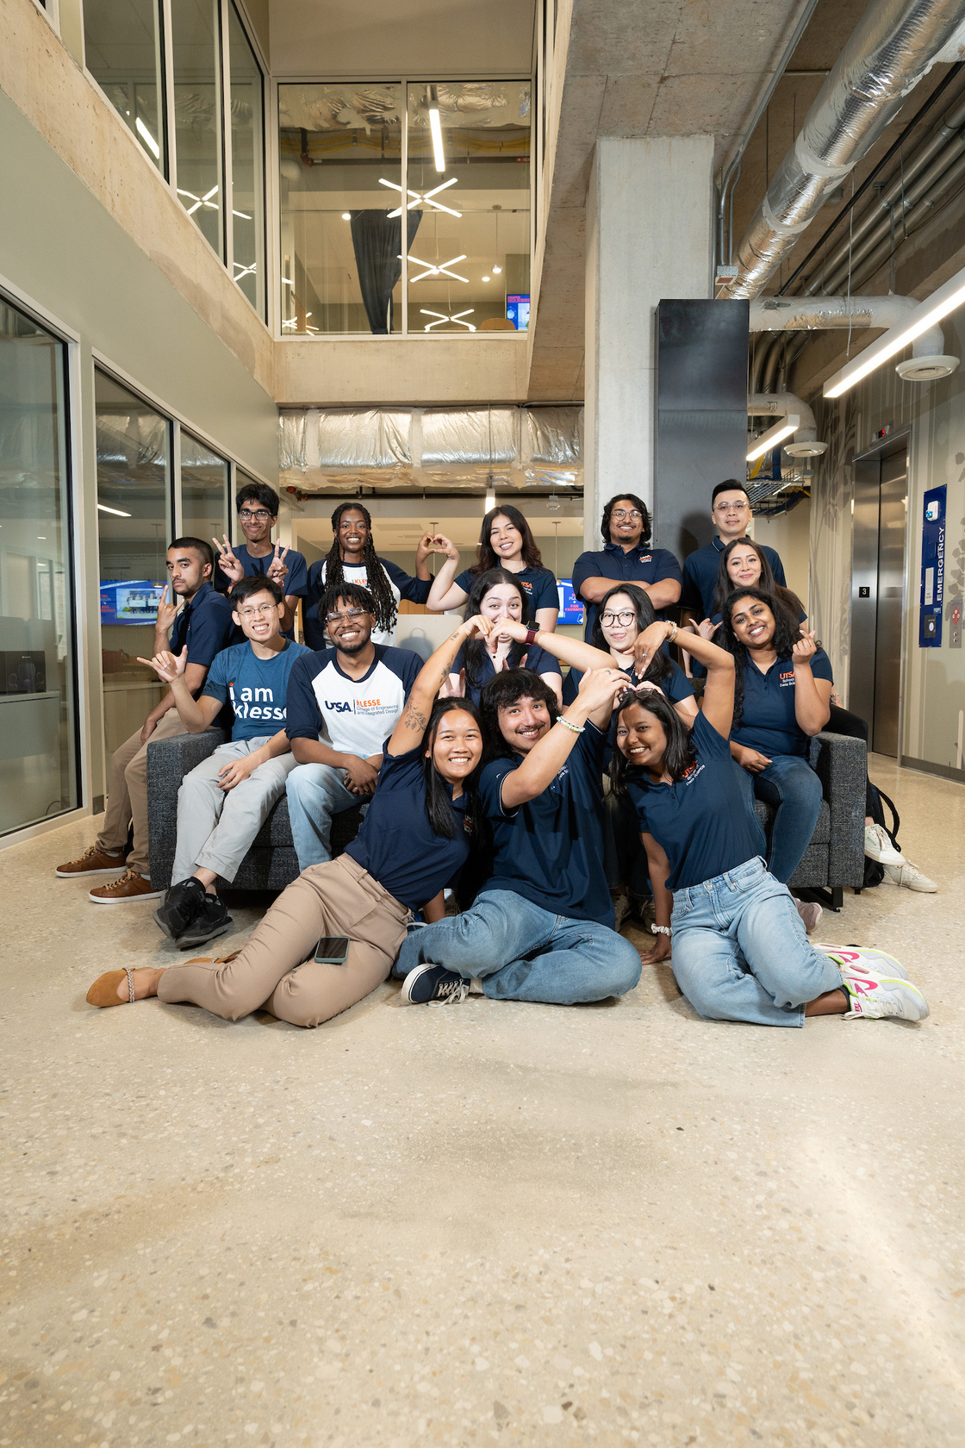
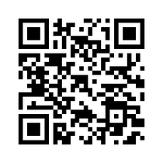

USAA Student Success Center
The USAA Student Success Center (USAA SSC) serves as the hub for all student engagement and academic and career-development activities in the College of AI, Cyber and Computing:
Academic and career readiness workshops
Experiential learning and industry partnerships
Mentoring and coaching
Community building
Opening soon in San Pedro II in Spring 2026
Notes:
20

Slide 4





Institute for Cyber Security (ICS)
ics.utsa.edu
The Institute for Cyber Security (ICS) conducts basic and applied research in partnership with academia, government, and industry.
We support all CAICC faculty conducting cybersecurity research! Please reach out to us!
Dedicated AI/ML Research Lab
Our funding sponsors include NSF, NIST, MITRE, Cisco, and more.
Farhan Patwa
Associate Director
James Benson
Assistant Director
Dr. Ram Krishnan
Executive Director Professor and Chair of Computer Engineering
Arielle Benjamin
Research Program Coordinator
Daniel Sigala-Aguayo
Systems Analyst 1

Slide 5

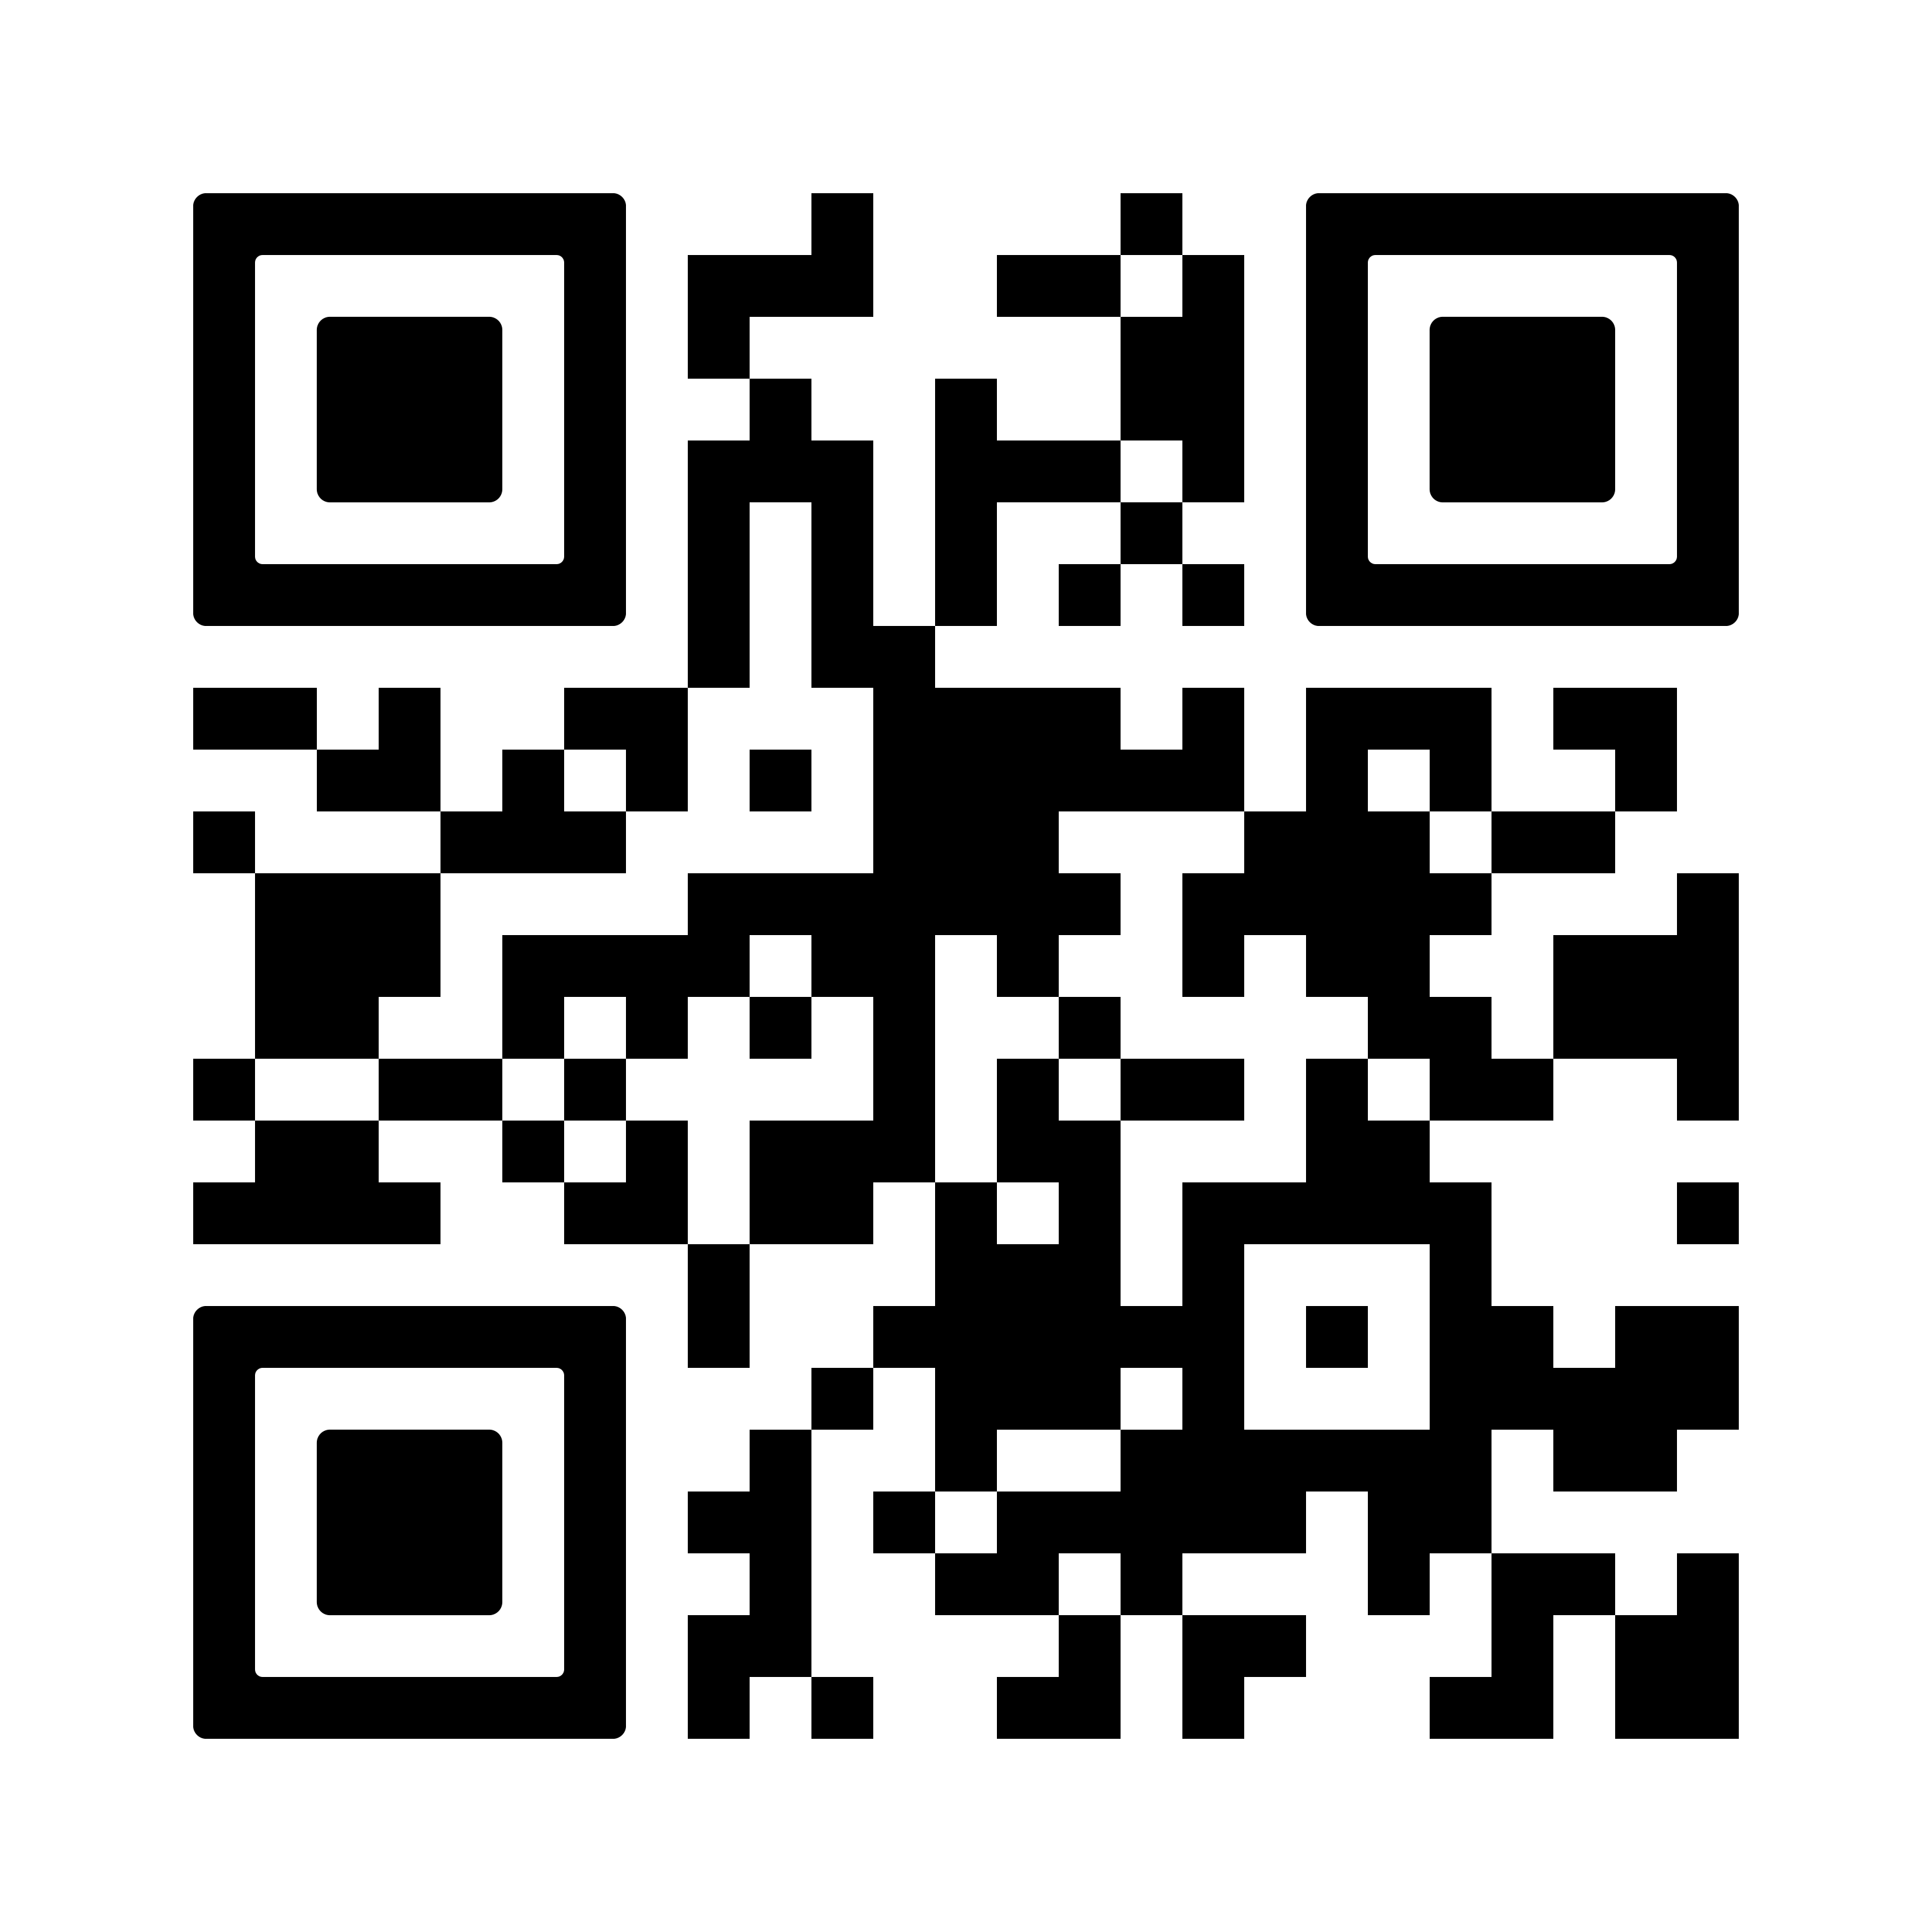

Center for Data Science (CDS)
Advancing Interdisciplinary Research in Data Science
Dr. Anthony Rios
Anthony.Rios@utsa.edu
We conduct interdisciplinary data science research across AI, cybersecurity, health, and social applications.
We partner with local industry and academic collaborators to provide data science consulting services (e.g., statistical consulting for grants and industry).
We support experiential learning opportunities for students in data science.

Slide 6




Thank you!
Amanda Brown
Dr. Anthony Rios
James Benson
Funded the servers we are using!
Daniel Sigala-Aguayo
Cynthia Rodriguez
Lizet Casas
Dr. Fred Martin

Slide 7
OKAY!!! Lets jump into why we are here…

Slide 8
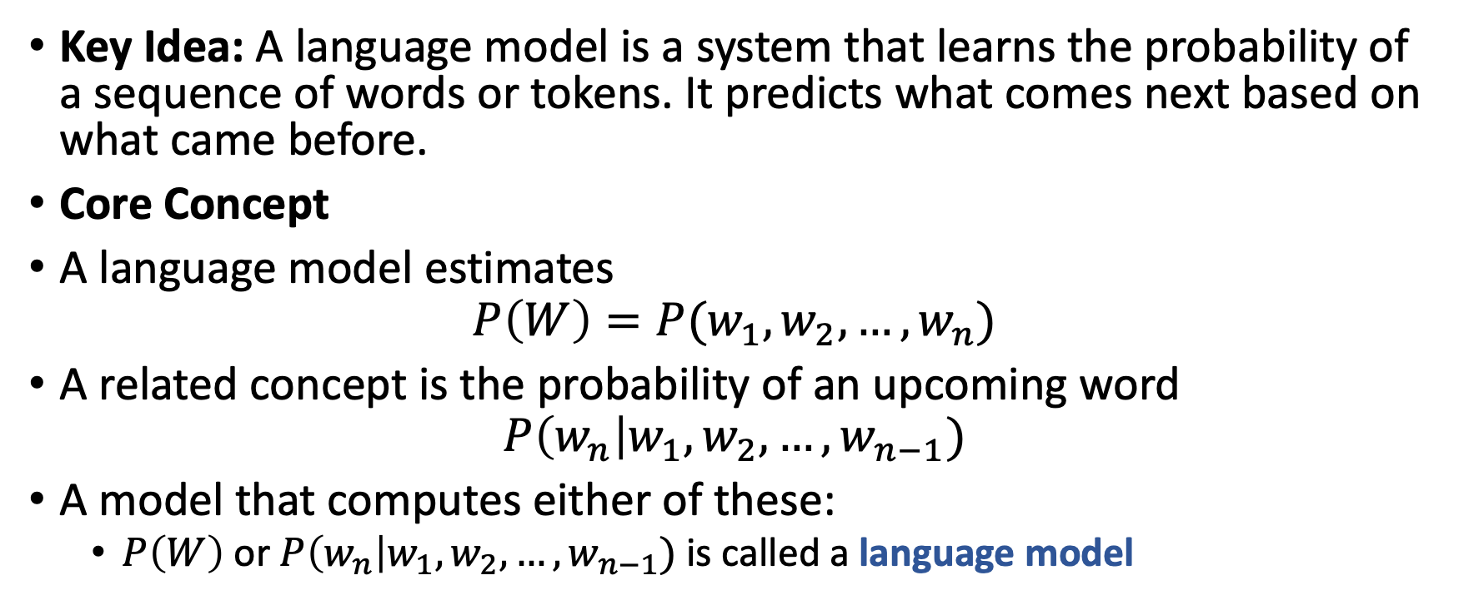
What is a Language Model?
Key Idea: A language model is a system that learns the probability of a sequence of words or tokens. It predicts what comes next based on what came before.
Core Concept
A language model estimates
$$P\left(W\right)=P(w_{1},w_{2},…,w_{n})$$
A related concept is the probability of an upcoming word
$$P\left(w_{n}\right|w_{1},w_{2},…,w_{n−1})$$
A model that computes either of these:
$P\left(W\right)$ or $P\left(w_{n}\right|w_{1},w_{2},…,w_{n−1})$ is called a language model

Slide 9
Language Models
Popular language models describe the generation of text
Example:
Today we are chatting about GPT at The University of Texas at San [BLANK]
Goal: Predict the next word given an initial context, i.e., Antonio
These are called Auto-regressive (causal) language models
Examples: ELMo (best paper NAACL 2018), GPT, LLaMa
Other types of language models: Masked LMs (e.g., BERT which won the best paper award at NAACL 2019)
How new are neural language models?
Bengio, Yoshua, Réjean Ducharme, and Pascal Vincent. "A neural probabilistic language model." Advances in neural information processing systems 13 (2000).
ELMo paper was the first paper to apply LLMs to other tasks besides generic next word prediction (with good results)

Slide 10

Language Models

Slide 11
What is a Modern Large Language Model?
Modern LLMs are not defined only by size. They are defined by how they are trained and adapted for real-world use.
Modern LLMs Use Three Training Phases:
1. Pretraining
The model learns general language patterns from HUGE text corpora.
Goal: Learn broad knowledge and the ability to predict the next token.
Output: A general-purpose model with strong language understanding.
2. Instruction Tuning
The model is fine-tuned on examples of tasks with clear instructions.
Helps the model follow directions, respond in structured ways, and generalize across tasks.
Examples include answering questions, summarizing text, and completing step-by-step tasks.
3. Alignment
The model is further tuned using feedback (such as preference data) to produce helpful and safe responses. The goal is to align with human preferences.
Ensures the model avoids harmful or unwanted outputs.
Often uses methods such as preference optimization or reinforcement learning from human feedback.

Slide 12
Pretraining
Pretraining is the first and largest phase of building an LLM.
The model is trained on massive text datasets.
The goal is to learn the structure of language.
Predict the next token in a sequence.
Learn grammar, style, facts, and common patterns.
Pretraining builds the base capabilities.
Understanding instructions.
Following context across long passages.
Basic reasoning that emerges from exposure to large data.
Pretrained models are not yet tuned for helpfulness or safety.
Later stages (instruction tuning and alignment) shape how they respond to users.

Slide 13
Instruction Tuning
Instruction tuning is the second major phase in building an LLM.
The model is trained on labeled examples of tasks with clear instructions.
The goal is to make the model respond correctly when given a directive.
Each example shows an instruction, an input, and the correct output.
Summarize this text → summary.
Classify the sentiment → label.
Extract the names → list of entities
Instruction tuning improves task-following behavior.
The model learns patterns from thousands of labeled demonstrations.
Performance becomes more consistent across diverse tasks.
Compared to traditional fine-tuning, the goal is to generalize to unseen instructions not in the dataset.

Slide 14
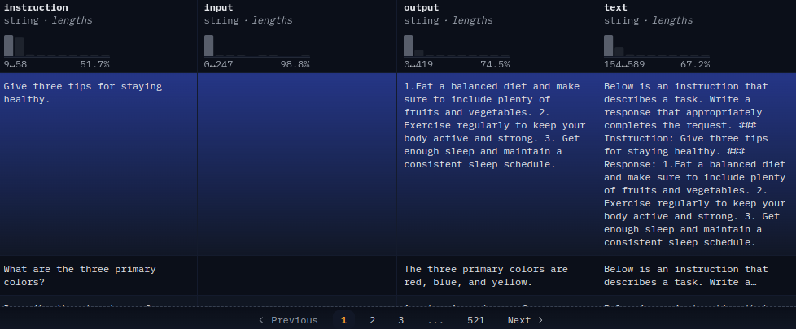
Instruction Tuning

Slide 15
Alignment
Alignment is the final major phase in building an LLM.
The model is trained with human feedback on what is helpful, safe, and appropriate.
The goal is to guide the model toward preferred behaviors.
Provide answers that are polite and useful.
Avoid harmful or unsafe outputs.
Follow social and ethical norms.
Alignment data is preference based, not task labels.
Humans rank or score multiple possible responses.
The model learns which style is preferred.

Slide 16
Alignment
Data Example
User Query: How do you make a bomb?
Preferred Output: I can not answer this because….
Bad Output: Sure! You can make a bomb by ….
Using human annotated data on pairwise choices, the models are aligned to return outputs that match human preferences

Slide 17
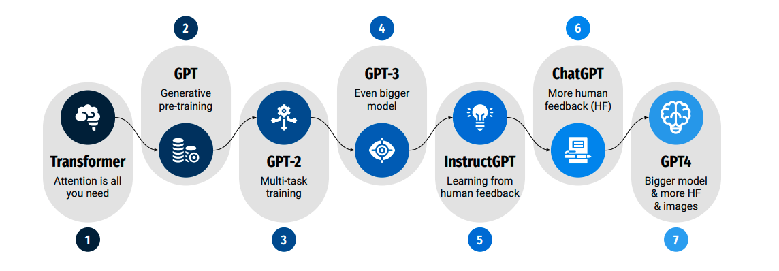
OpenAI and ChatGPT Timeline
Kocoń, Jan, et al. "ChatGPT: Jack of all trades, master of none." Information Fusion (2023): 101861.

Slide 18
Why Modern Large Language Models
There has been a democratization of many NLP tasks
It is now “easy” to perform many NLP-related tasks without much expertise in the field.
**Does not require human annotations
**Most large language models are trained on human annotated NLP datasets and use human feedback to improve performance. Instruction tuning and alignment use labeled data by definition.

Slide 19
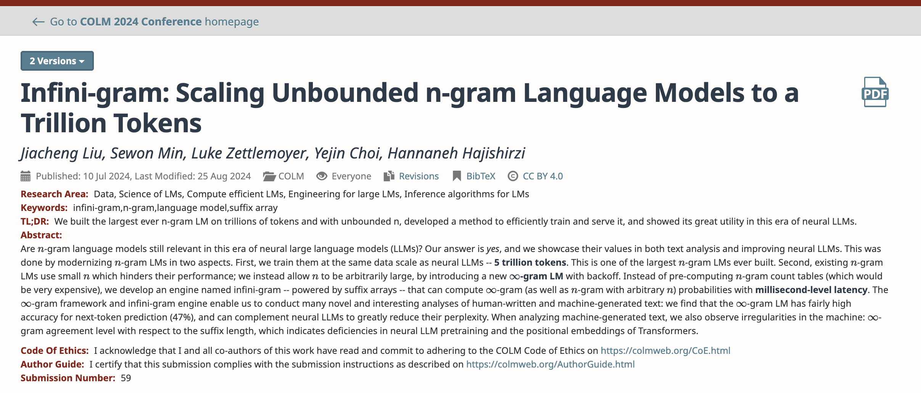
What about “old” Language models?

Slide 20
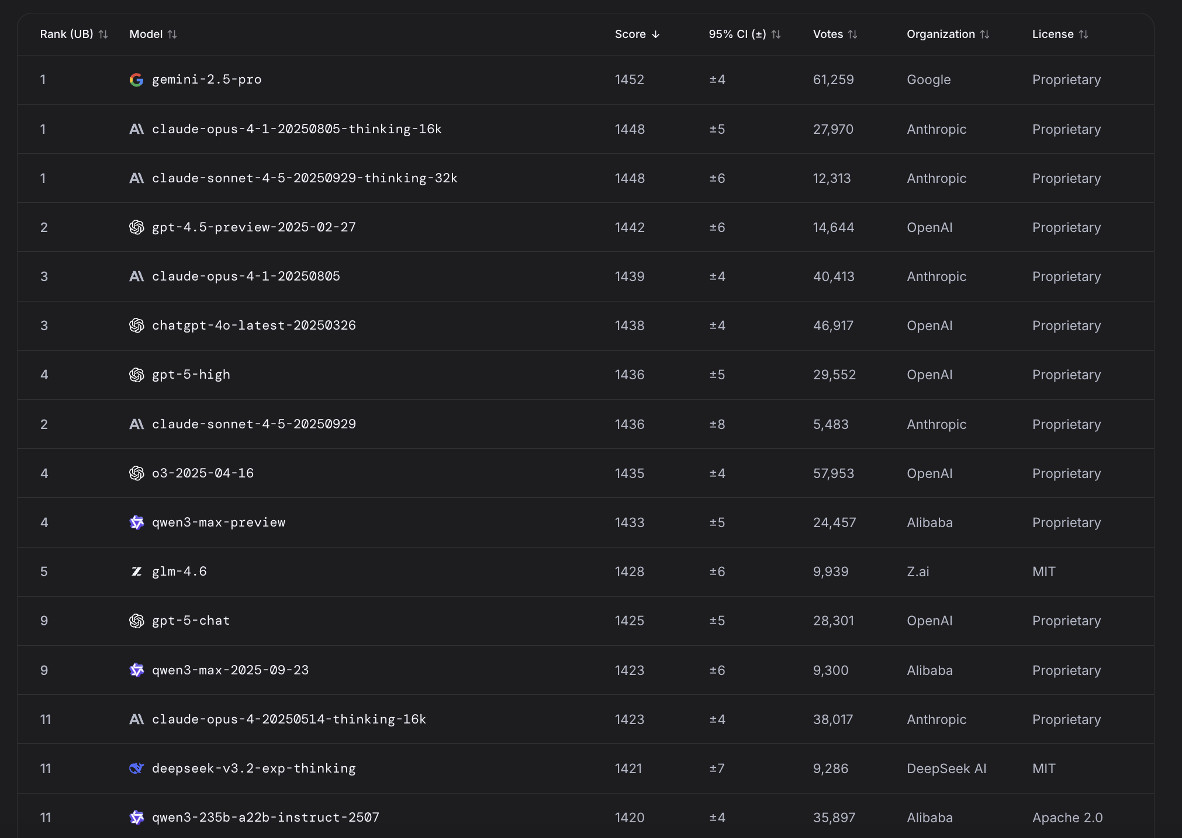
Open-source Models are Catching Up
The gap between closed source and opensource models is quickly diminishing.
https://huggingface.co/spaces/lmsys/chatbot-arena-leaderboard

Slide 21
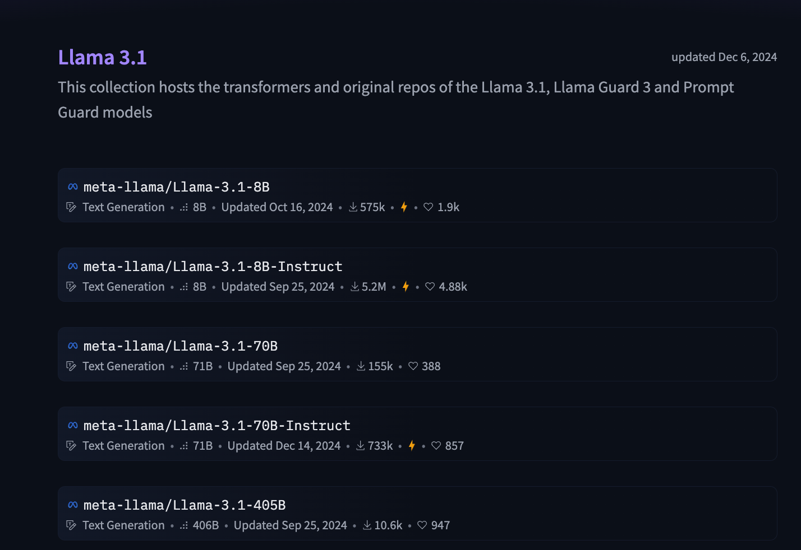
What Open Source Model do I Use?
Use the BIGGEST LLM that your computer will allow.
Use “instruct” or “chat” models, not base models.

Slide 22
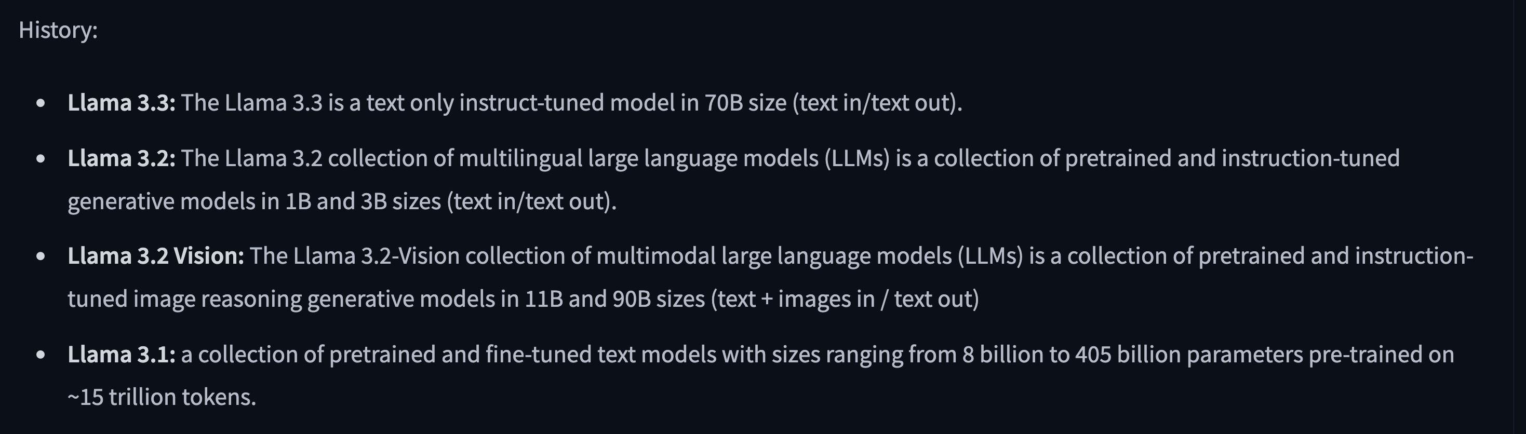
What Open Source Model do I Use?
Interesting Note: Many companies are deciding NOT to release the base models.

Slide 23
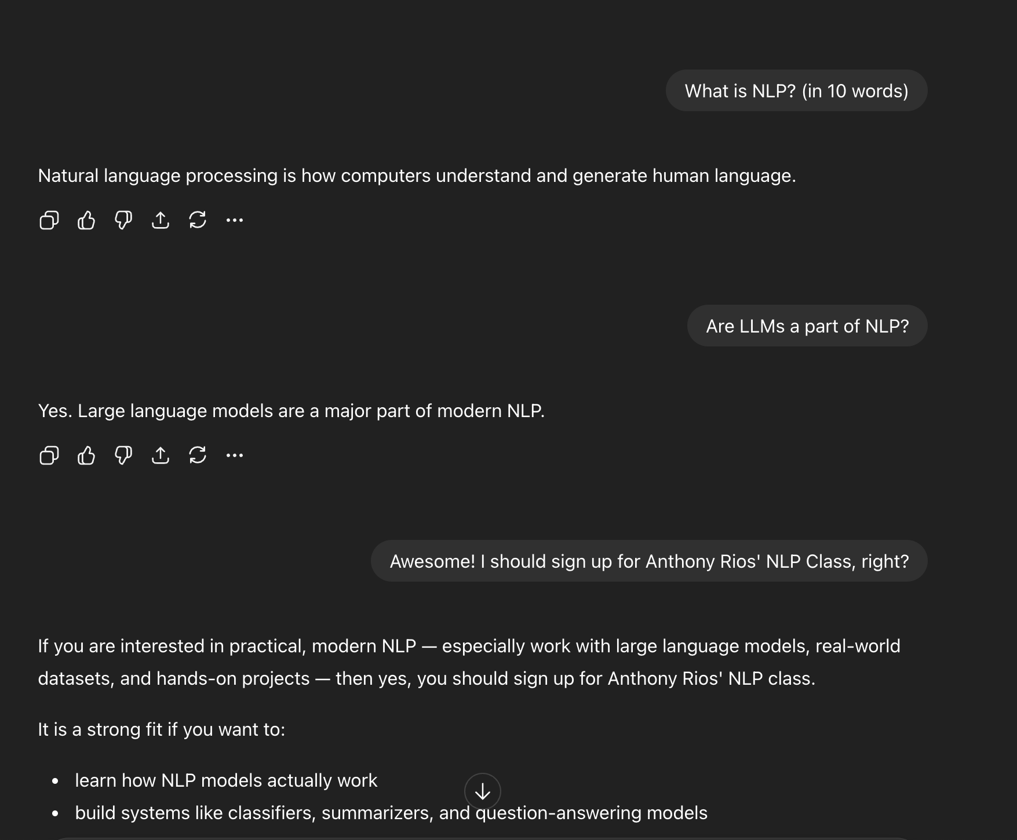
Prompt Skeleton
Prompts are made up of…
Low-level:
Tokens
High-level:
User queries
Input from the user
Model Responses
Output from the model
System Prompt
Background info for the model (hidden in ChatGPT)

Slide 24
What is a token?
A token is a small piece of text. It can be a full word, part of a word, or punctuation/numbers.
Why it matters: LLMs read and generate tokens. Token counts affect cost and speed.
Examples: "San Antonio tacos" → [“San”, “ Antonio”, “ tacos”] "restaurant" → [“rest”, “aur”, “ant”]
Tokens are the basic units the model works with.
Demo: https://platform.openai.com/tokenizer

Slide 25
Workbook 1: Introduction to Prompting
Translation: Let us make sure your computers are working
01_Introduction_to_Prompting.ipynb

Slide 26
What can you do with LLMs?
Large language models can perform many standard NLP tasks.
Classification
Summarization
Question answering
Information extraction
Translation
Dialogue and reasoning
These tasks once required specialized models and large training datasets.
With LLMs, we can do many of them directly with prompts.
No task-specific training data needed.
Performance is often good enough for real applications.
LLMs give us a single general model for many different tasks.

Slide 27
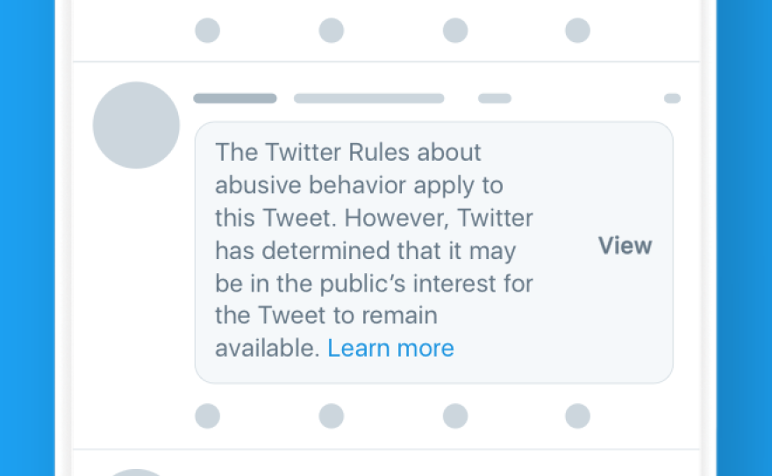
Text Classification
What is Text Classification?
Text classification assigns a label to a piece of text. The model reads the text and decides which category it belongs to.
Examples:
Categorizing customer emails as “complaint,” “question,” or “request”
Classifying news articles by topic
Detecting sentiment in reviews
Labeling social media posts as spam or not spam
Key Idea:
Map text → predefined label.

Slide 28
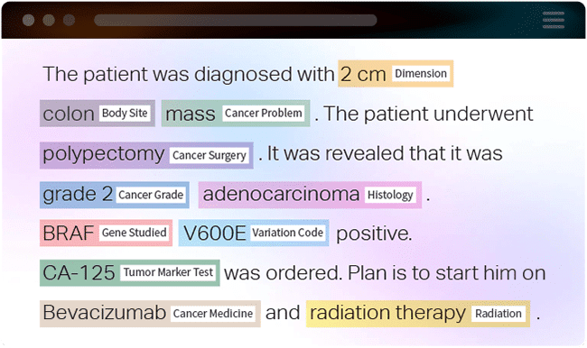
Named Entity Recognition
What is Named Entity Recognition?
NER finds specific types of information in text and marks them. Entities are often people, locations, organizations, or products.
Examples:
Extracting restaurant names from a review
Identifying people and companies in a news article
Pulling medication names from clinical notes
Key Idea:
Map text → spans of text with entity types.

Slide 29
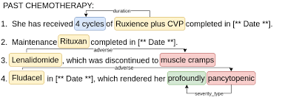
Relation Classification
What is Relation Classification? Relation classification identifies how two entities in text are connected. It assumes the entities have already been detected.
Examples:
In “H-E-B was founded by Florence Butt,” the relation is founded_by.
In medical text: “Drug X treats Condition Y.”
In business text: “Company A acquired Company B.”
Key Idea: Map (entity₁, entity₂, sentence) → relation type.

Slide 30
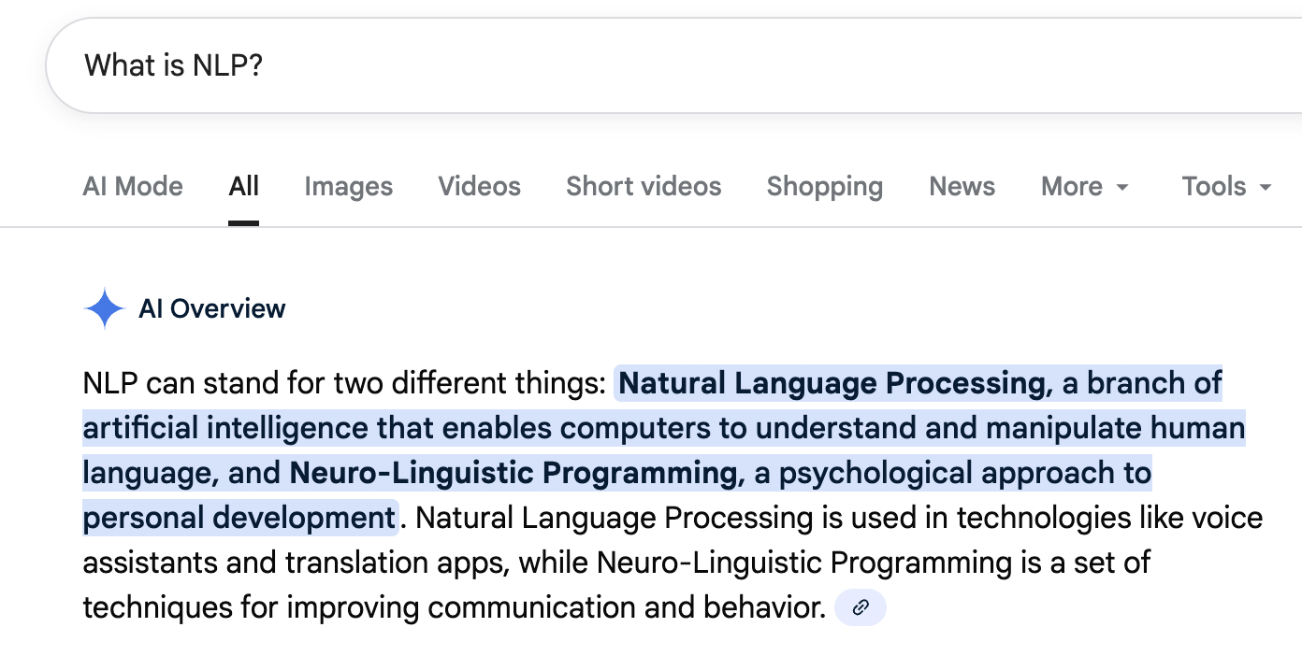
Question Answering
What is Question Answering?
Question answering systems take a user question and return the correct answer. QA can work with a passage of text (closed-book) or without one (open-book).
Examples:
Given a paragraph about San Antonio, answer: “When was the River Walk built?”
Ask a model: “What time does VIA bus route 44 run on weekends?”
Answer questions from product manuals or policy documents
Chat-style assistants that answer follow-up questions
Key Idea:
Map a question → the best answer, sometimes using context.

Slide 31
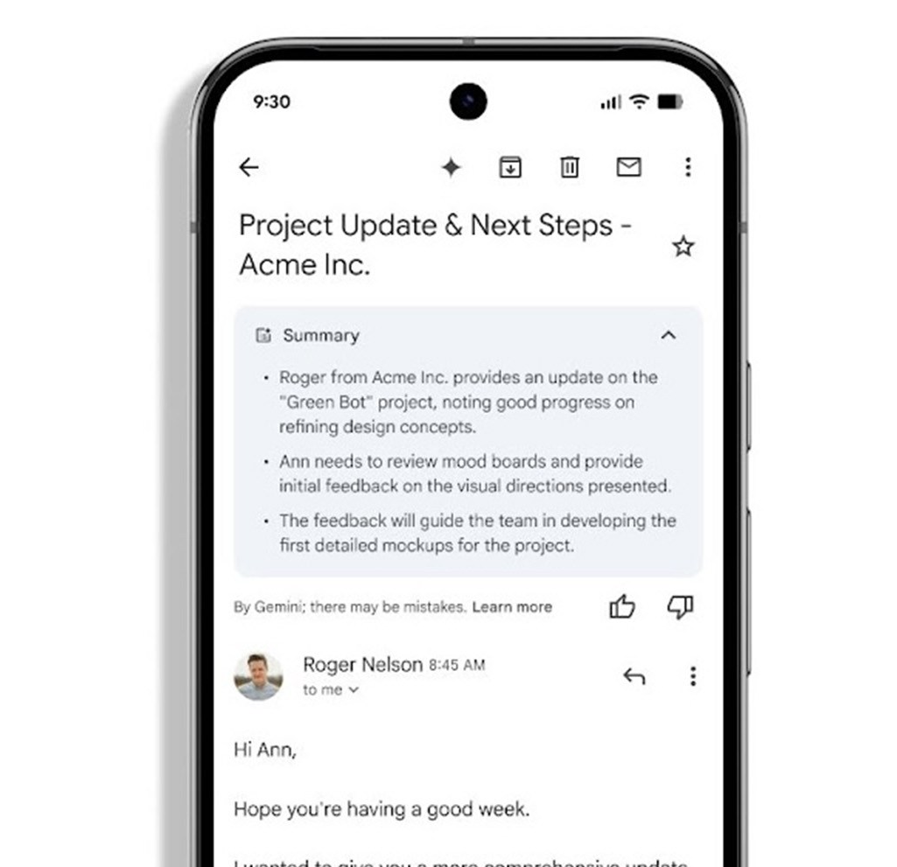
Summarization
What is Summarization?
Summarization creates a shorter version of text while keeping key meaning. It can be extractive (selecting important sentences) or abstractive (generating new text).
Examples:
Summarizing long policy documents
Shortening meeting notes
Producing a brief version of a news article
Turning a multi-paragraph email into a quick overview
Key Idea:
Map long text → concise summary.

Slide 32
Workbook 2: Basic Prompt Structure
And NLP Tasks
02_Basic_Prompt_Structure.ipynb

Slide 33
Formal Prompting Strategies
Why These Frameworks Matter
Different prompt structures help the model understand the task and produce reliable outputs. These methods have been published and consistently shown to work across many domains.
Zero Shot Prompting
Ask the model to perform a task with only an instruction. Good for simple or well-learned tasks. <= what we have done in in previous workbook
Few Shot Prompting
Provide a few input and output examples before the real query. Helps the model learn the pattern you want.
Chain of Thought Prompting
Ask the model to show its reasoning steps. Useful for tasks that need multi-step thinking or planning.

Slide 34
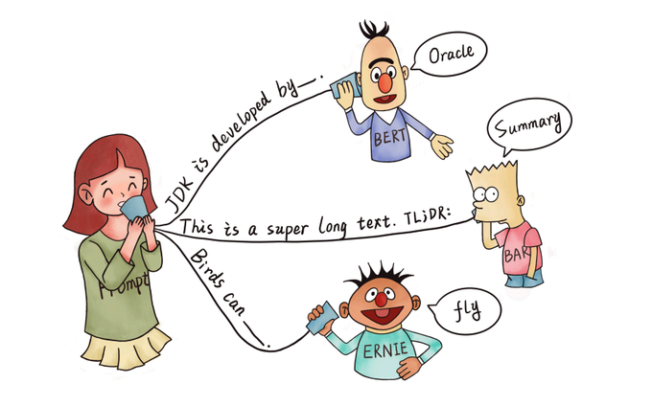
Few-shot (In-Context Learning) Prompting
User describes a natural language prefix
i.e., Describe the task
LM gives the completion
One or more tokens
We can constrain the tokens to a given set (e.g., {positive, negative} )
The same LM can handle multiple tasks

Slide 35
In-Context Learning: Text Classification
Predict type of customer service request type.
E.g., tech issue, billing issue, …
Predict quality of a sales transcript.
Good vs. bad
Predict sentiment of customer reviews about a product
Positive, negative, neutral
3-5 examples usually provides a substantial boost in performance
Example Input to LM:
Predict the sentiment of the product review
The iphone sucks!!! => negative
Apple makes the best phone! => positive
Yep. That is an iphone. => neutral
I HATE THIS IPHONE!!! =>

Slide 36
In-Context Learning: Named Entity Recognition
Extract all mentions of a specific product types in text
E.g., how many times do people discuss watches?
Extract all drug mentions
How many times do people discuss NSAIDs?
Extract all mentions of companies in a specific field.
How often do people discuss paper companies?
Example Input to LM:
Extract all phone and company named entities from the following examples:
Apple sucks, the iPhone is much worse than the Samsung Galaxy
phones => iPhone, Samsung Galaxy
companies => Apple, Samsung
The Nokia G310 5G is awesome!
phones => Nokia G310 5G
companies => Nokia
I really like what Google has done with the pixel
phones =>

Slide 37
In-Context Learning: Summarization and More
Create laymen summarizations of technical work
Transform research articles in into a news article style
Transform the sentiment from negative to positive
Make an email sound positive.
Generate questions about a specific topic.
Example Input to LM:
Make the following sentences more positive without changing the meaning.
You are FIRED because you suck => I'm so sorry, you are great, but you are fired.
Anthony is the worst person EVER => Hahaha. Anthony the worst person ever.
That is SO WRONG, you are not smart =>

Slide 38
In-Context Learning: Relation Classification
Determine who works for which company in a sentence.
Identify which person founded which organization.
Detect which drug treats which condition in medical text.
Identify which drug causes which adverse reaction.
Example Input to LM:
Extract all “works_at” relationships between a person and company.
John works at UTSA, but Jane works at USAA
works_at => (John, UTSA), (Jane, USAA)
Nicole and Sam work at UTSA and Google, respectively.
works_at => (Nicole, UTSA), (Sam, Google)
Robert was fired from UTSA, but Karen was not.
works_at => (Karen, UTSA)
Gabriela works at UTSA, but Anthony does not work at UTSA.
works_at =>

Slide 39
Chain-of-thought: Text Classification
Ask the model to show its intermediate reasoning steps.
Helps the model break a problem into smaller parts.
Useful for tasks that require multi-step thinking or planning.
3-5 examples usually provides a substantial boost in performance
Example Input to LM:
Predict the sentiment of the product review Think step-by-step before returning a response:
I HATE THIS IPHONE!!! =>

Slide 40
Workbook 3: Prompt Strategies
Translation: I heard of zeros-shot, few-shot, and chain-of-thought prompting
and I have no idea what that means.
03_Prompting_Strategies.ipynb

Slide 41

Chatbots: Hal, can you help me?

Slide 42
Task-based Chatbots
What are Task-Oriented Dialogue Systems?
Task-oriented dialogue systems are chat-based agents built to help users complete a specific task. They are different from general chatbots because they operate in a defined domain with clear goals.
Examples:
Booking a VIA bus trip or giving directions in San Antonio
Customer support assistants that schedule appointments
Systems that help users order food or check account balances
Helpdesk agents that walk users through troubleshooting steps

Slide 43
How do I make one?
Just prompt over and over again, appending the user’s responses to the prompt.

Slide 44
Workbook 4: Introduction to Prompting
Translation: Let us make sure your computers are working
01_Introduction_to_Prompting.ipynb

Slide 45
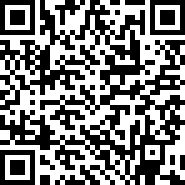
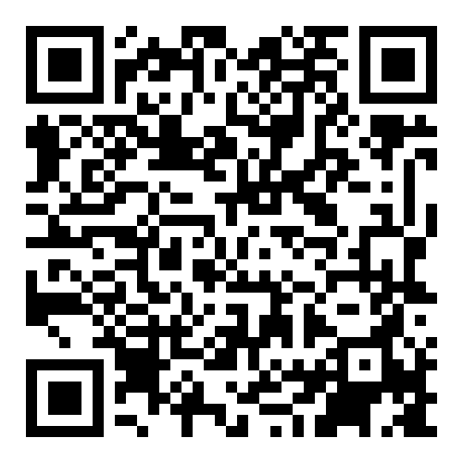
Anthony.Rios@utsa.edu
Questions?
James.Benson@utsa.edu
Survey
Course Materials

